Slide 1
Atlas Itinerary
By Gabriel Taylor, Dustin Zook, Sorelle Djuissi, Gabriyel Sorensen

Slide 2
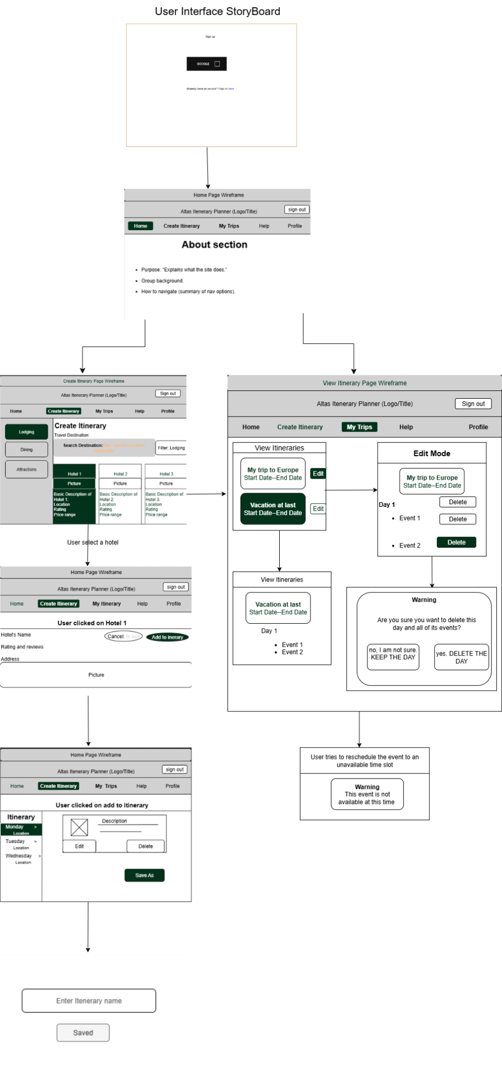

Slide 3
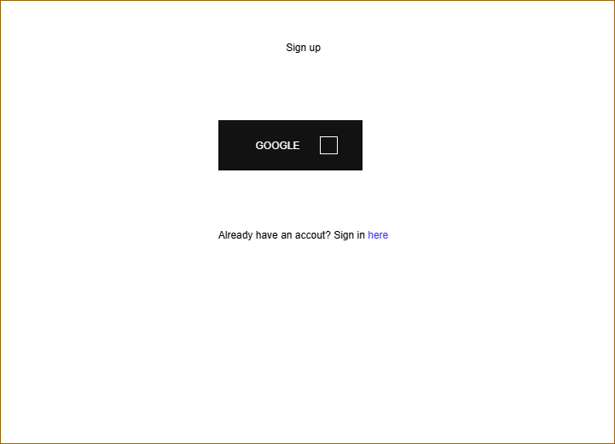
Sign-up and sign in page
Google API backbone
Link to Sign-in page

Slide 4
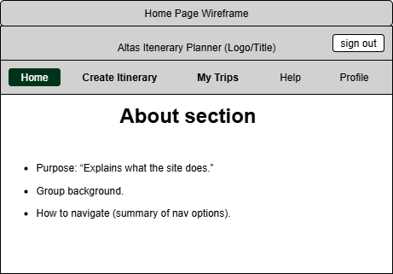
The Home Page
About Section
Instructions
Personnel
Nav Bar

Slide 5
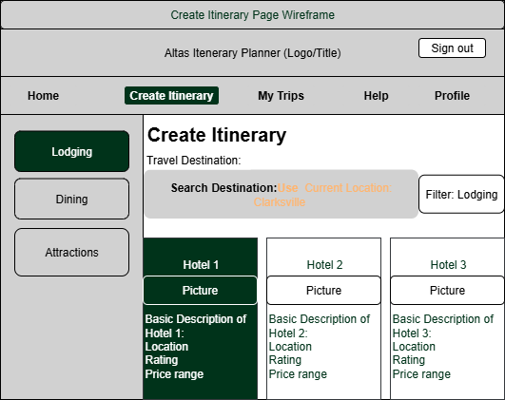
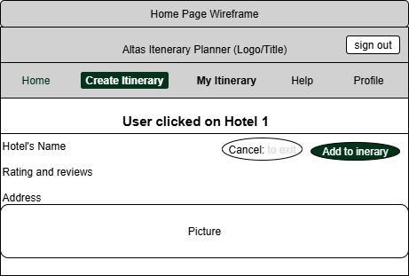
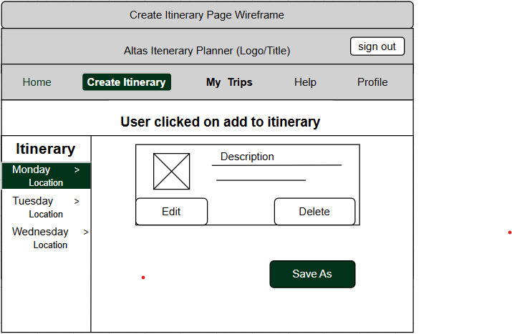
Create Itinerary
Travel destination
Geolocating
Location categories
Subcategories in the filter
Successful Completion

Slide 6
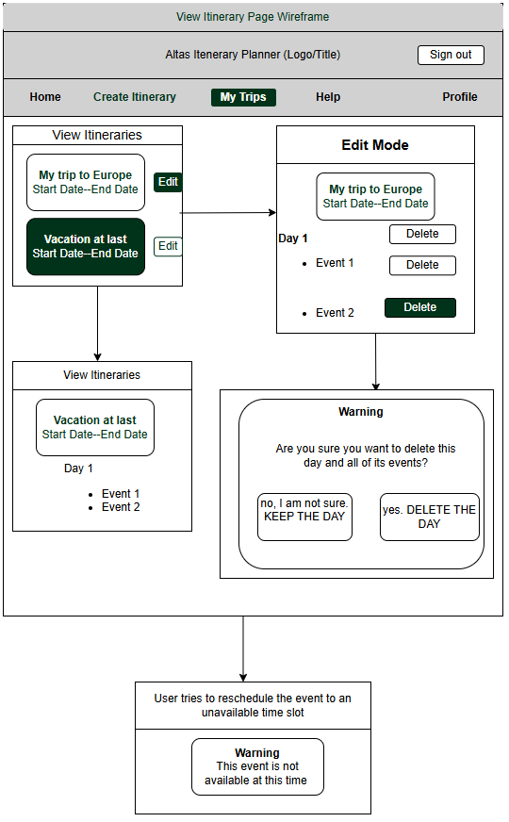
View Itinerary
Empty Page
Card Presentation (and Contents)
Expanded cards
Edit mode (both event and day)
Warning

Slide 7
THE BACK END

Slide 8
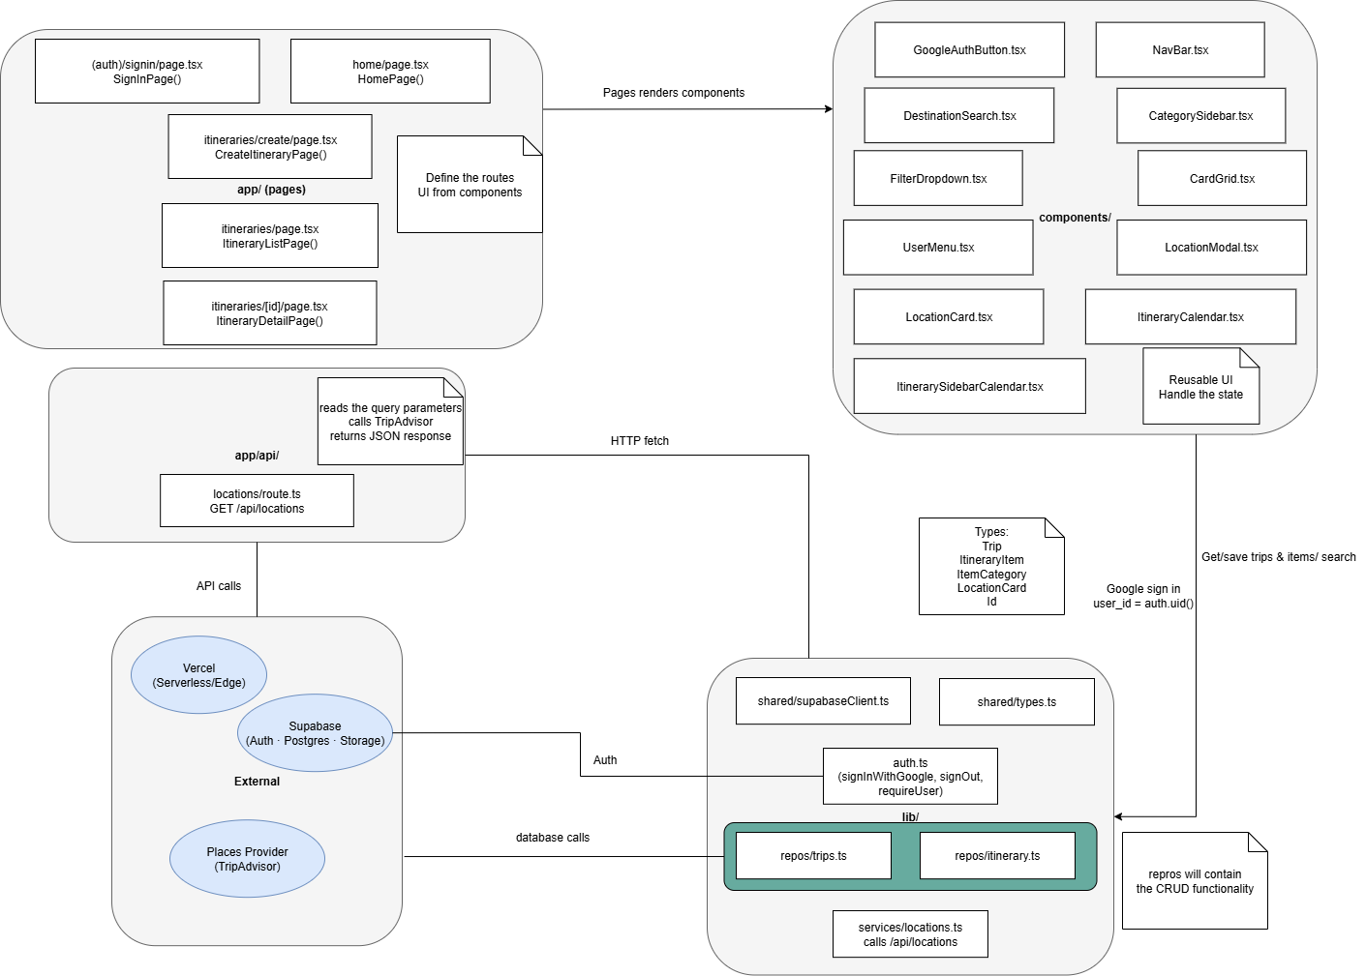
React
How it works
How it fits with the project
Examples of how it will be used
Sharing is caring (and more efficient)

Slide 9
All of the many components of React

Slide 10
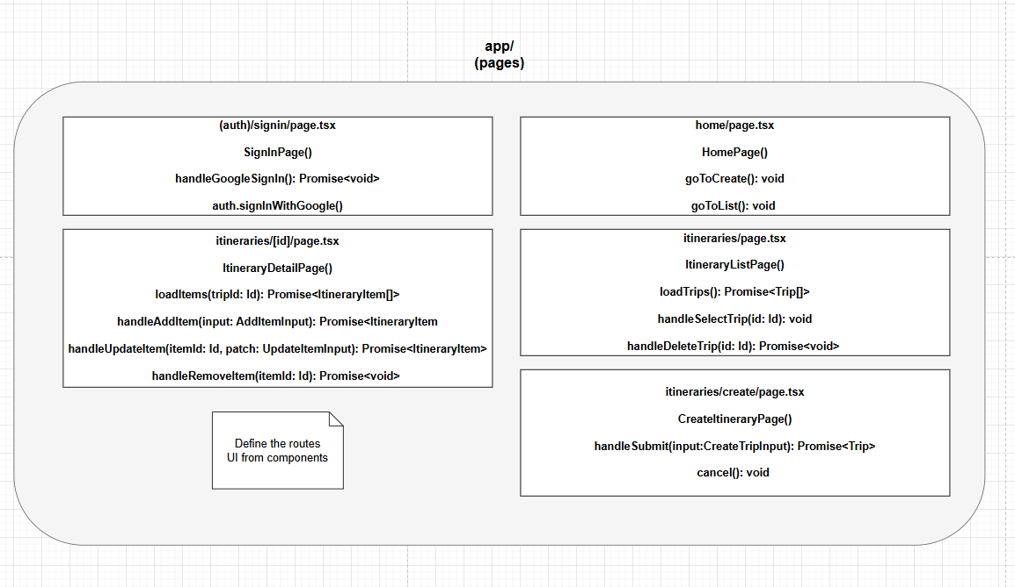

Slide 11
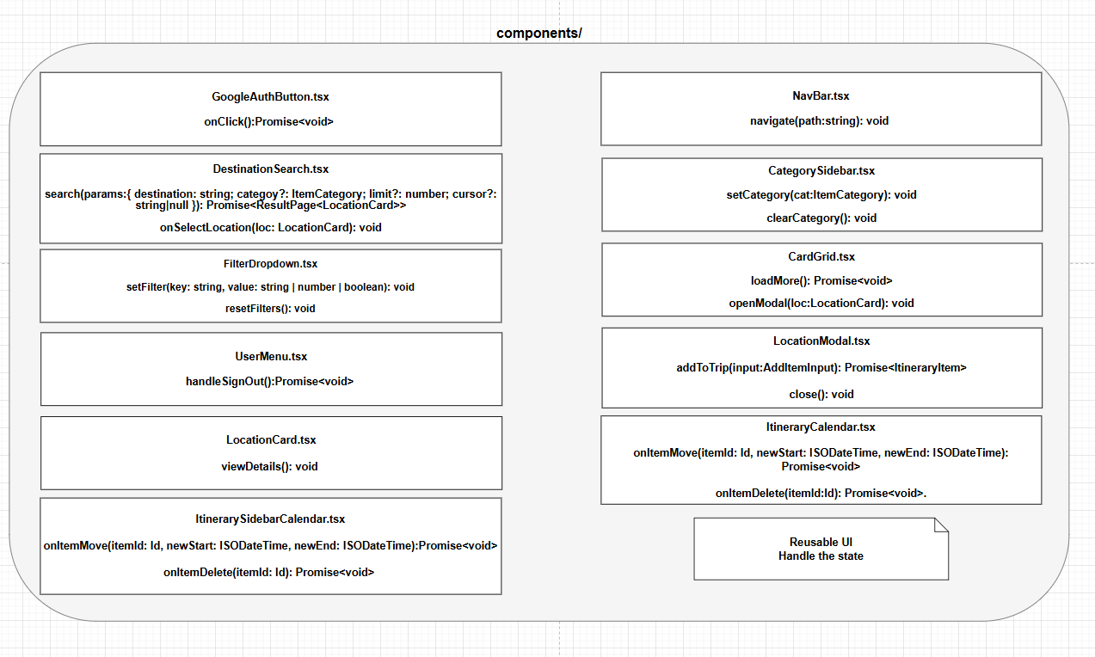

Slide 12
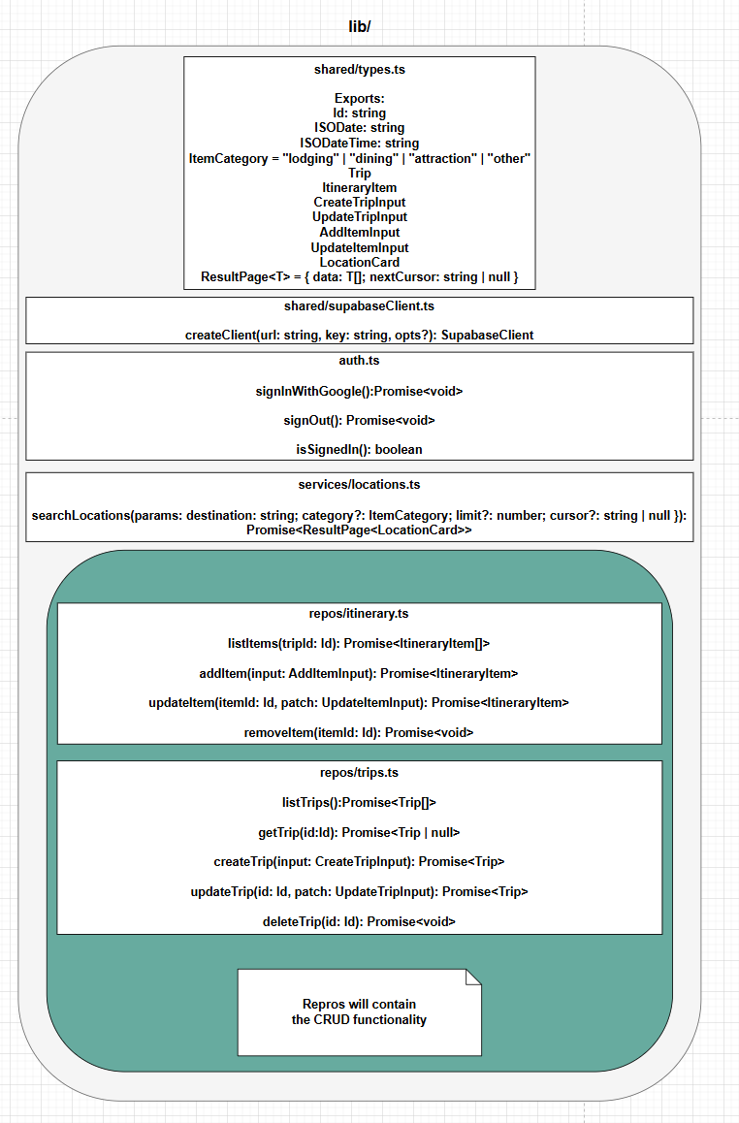

Slide 13
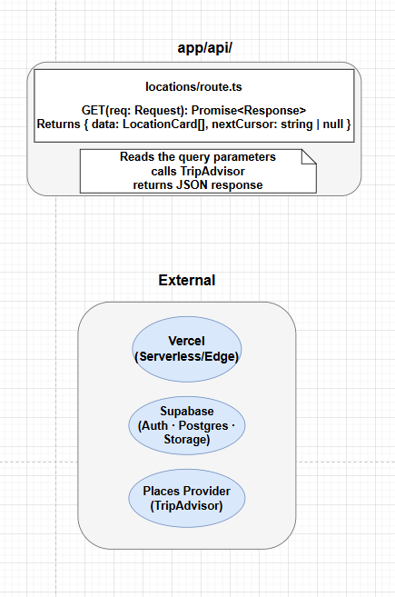

Slide 14
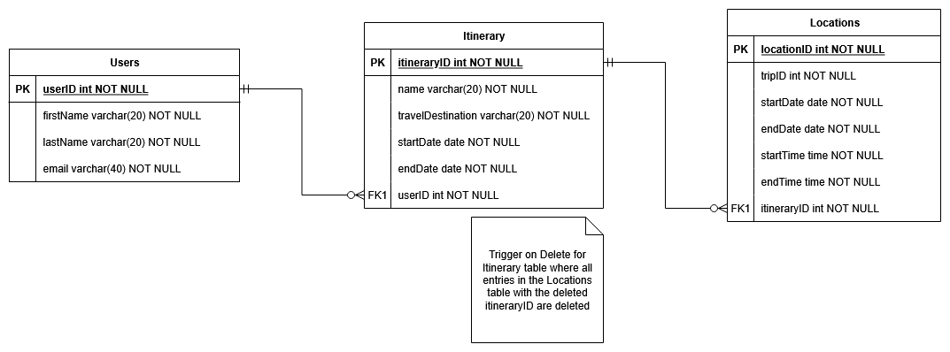
SupaBase
How it will help
The entities of the database

Slide 15
VERCEL
Server base
Analytics
Breakdown

Slide 16
Why each Software Program was chosen
Familiarity and ease of use with React
Compatibility with Supa
Simplicity with Vercel

